Slide 1
First Class Support for College Students on the Autism Spectrum: Practical Advice for College Counselors and Educators
Dr. Michael Duggan, LCRC, CRC
Counselor for Students with Disabilities/Professor
Website: michaelwduggan.com
Email: michaelwduggan@yahoo.com

Slide 4
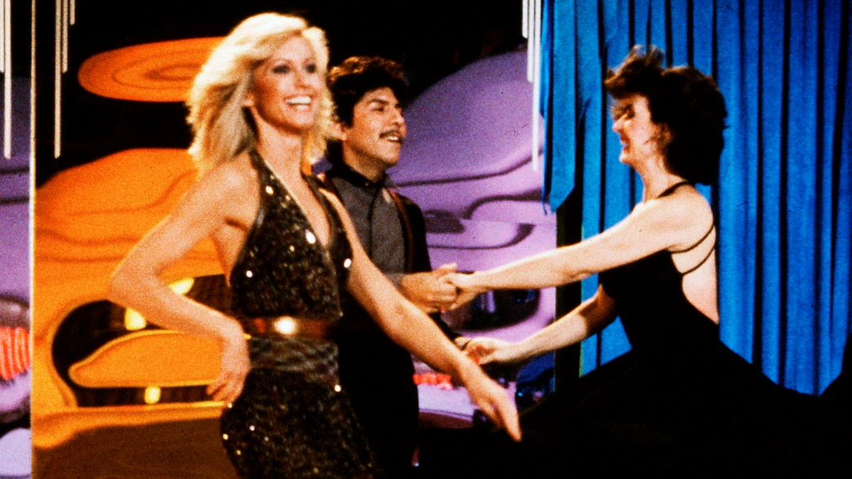

Slide 8
“My First Failure”
Chapter 1

Slide 10
Me
Shit!

Slide 11
“The Phantom Success Story”
Chapter 2

Slide 12
Weblink

Slide 13
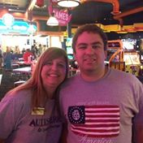

Slide 14
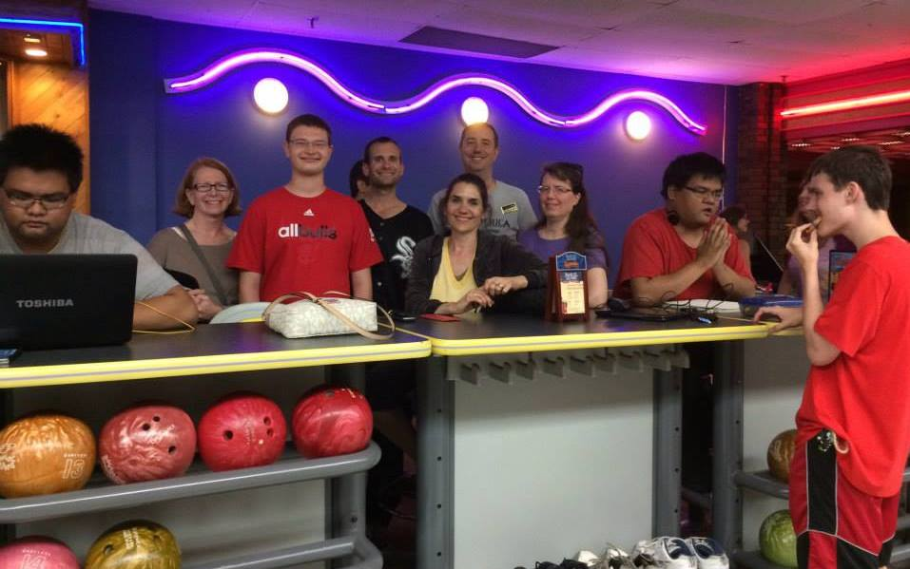

Slide 15
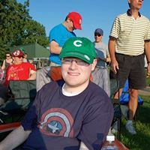

Slide 18
“What Students on the Spectrum Want Us to Know”
Chapter 8

Slide 19
What its Like to Walk Down the Street

Slide 20
“What Makes a Good Counselor, Service Provider or Instructor?”
Chapter 12

Slide 21
Elements of Success for Educators
Make an effort to understand the students world view and/or ”hooks”
Help students develop a sense of structure for homework & studying (when, where, etc.)
Work with students to develop a means of accountability
Help students better define the expectations for being a successful student (how to prep for exams, write papers, working in groups, etc.)
Role play more difficult conversations like job interviews or asking for help from instructors
Work to develop means for socialization outside of students homes
Recognize the role anxiety can play and talk about it
Always remember every student is unique
Keep parents involved but encourage autonomy
Look regularly for opportunities to expand the students support network
RELAX!

Slide 23
COD Buddies

Slide 24
“What I Wish Parents, Students, & Everyone Would Know”
Chapter 15

Slide 25
Elements of Success for Students
Having an understanding of ones diagnosis
Some ability to self-advocate, even if on a very basic level
Ability to succeed in education for classes that are homework-based or exam-based
Some type of outside work experience (paid or volunteer)
A desire to continue with ones education (VERY IMPORTANT)
Some ability to manage time to do homework successfully and independently
Minimal involvement of parents in completing homework (if any!)
An ability to control and monitor the degree of ones gaming and technology use
A parent (s) with a realistic understanding and expectation of their child’s abilities, strengths, and deficits
A parental openness to continuing to be involved in their children’s education (with limits)

Slide 26
Epilogue: Michael Duggan’s Tips for Success in Higher Education and Life

Slide 27
Epilogue: Michael Duggan’s Tips for Success in Higher Education and Life
1. Always appreciate
2. Look for gaps in services
3. Seek out opportunities to work outside your department
4. Be the listener, not the talker
5. Never take interruptions when with students unless absolutely necessary

Slide 28
Epilogue: Michael Duggan’s Tips for Success in Higher Education and Life (cont.)
6. Never let important ideas be forgotten
7. Students need personal, genuine connections
8. Seek out any and every opportunity to speak in front of others
9. The people on the front lines are usually the hardest working and least appreciated ones out there
10. Students are the best judge if you’re doing a good job

Slide 29
Epilogue: Michael Duggan’s Tips for Success in Higher Education and Life (cont.)
11. Don’t be afraid to bend the rules of buck the system, a little
12. Laugh more, worry less
13. Family and loved ones first
Don’t take everything too seriously and calm the @#$(*&#$ down!!!
15. If you don’t love it, quit. Please!!!!!

Slide 30
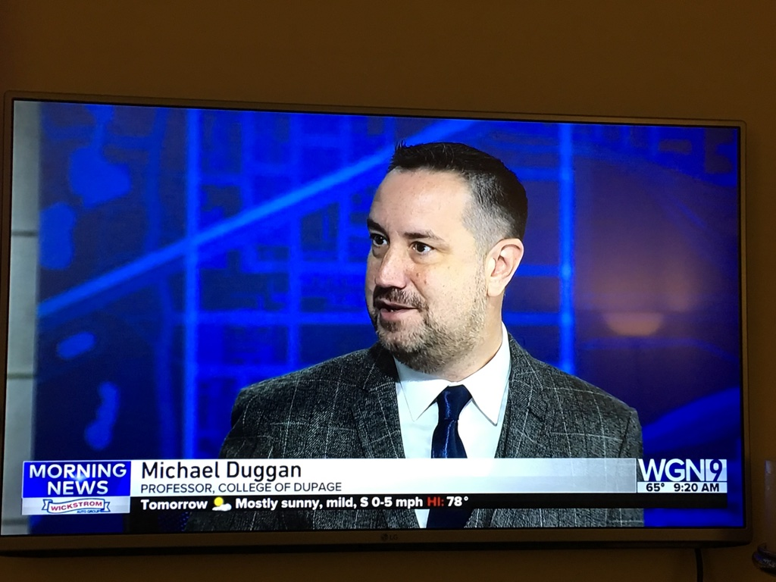
WGN News

Slide 33
First Class Support for College Students on the Autism Spectrum: Practical Advice for College Counselors and Educators
Dr. Michael Duggan, LCRC, CRC
Counselor for Students with Disabilities/Professor
Website: michaelwduggan.com
Email: michaelwduggan@yahoo.com

